Slide 1


Bluetooth Controlled Obstacle Avoiding Car
Group Coursework Presentation Slide
CC5068NI - Cloud Computing and the Internet of Things
Section: L2N5
Team: 4
London Met ID | Student Name
22066691 | Manish Koirala
22066696 | Satyam Singh Rajput
22066461 | Dipendra Gautam
22066738 | Subin Karmacharya
22066692 | Anusuya Chudal

Slide 2
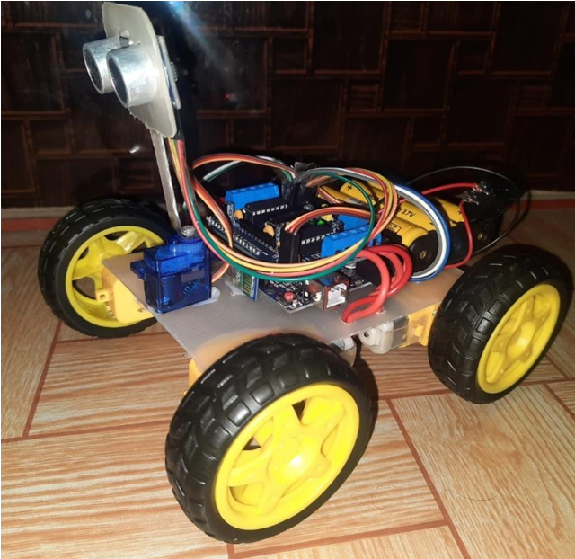
Introduction
Bluetooth Controlled Obstacle Avoiding Car
detect obstacles in its path,
Bluetooth module allows wireless communication,
autonomous navigation.

Slide 3

Project as a solution
- to lower the risks of road accidents
- to help improve safe navigation and road safety

Slide 4
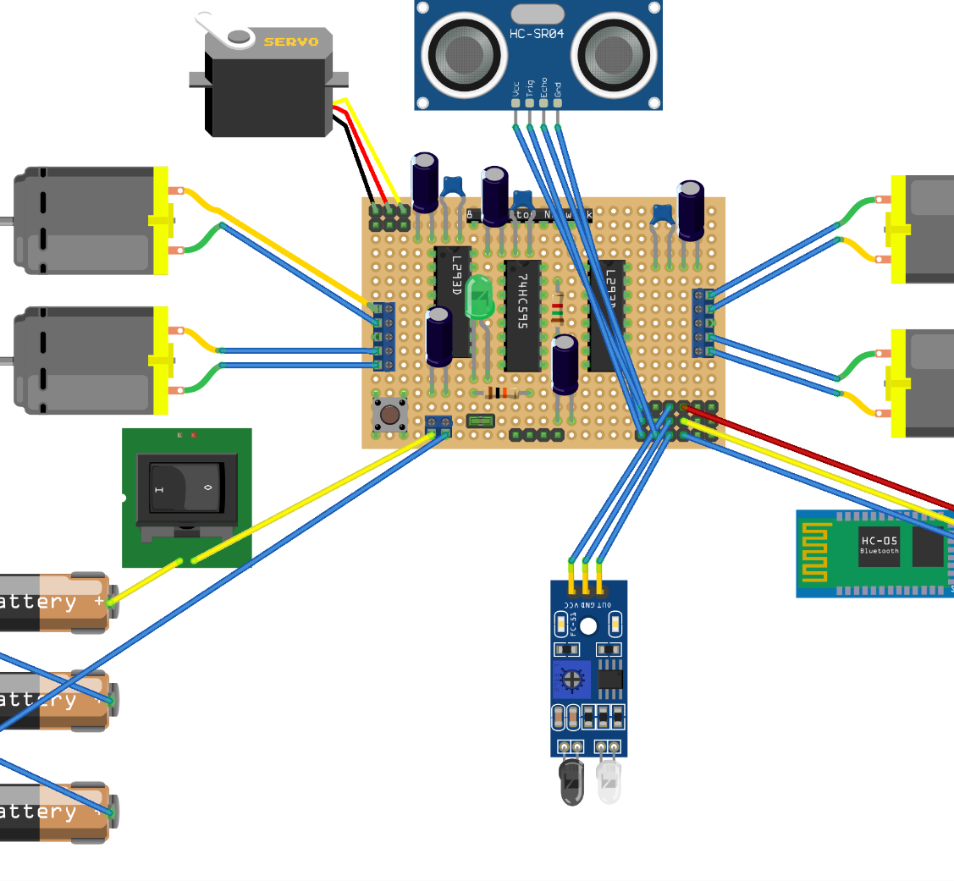
Circuit Diagram
This is our Circuit Diagram of our Obstacles Avoidance car Project

Slide 5
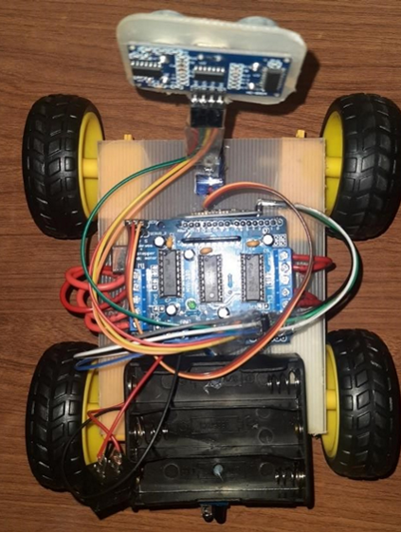
Wiring and Connection
The components are connected to the motor driver shield as follows:
Bluetooth Module:
Rx connected to Pin A3
GND connected to GND
VCC connected to power Supply voltage(VCC)
Ultrasonic sensor:
Echo connected to pin A1
TRIG connected to pin A0
GND connected to GND
VCC connected to power supply voltage(VCC)

Slide 6
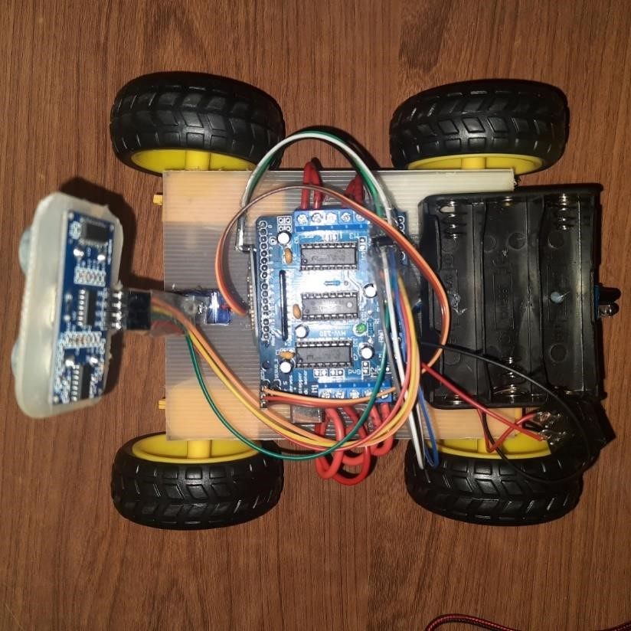
Wiring and Connection
Active Infrared Sensor
GND connected to GND
VCC connected to Power Supply(VCC)
Out connected to pin A2
Servo motor
GND Black wire connected to GND
VCC Red wire connected to power supply voltage(VCC)
SIG Yello wire connected to digital pin 10
Motors and battery are connected to their respective terminals on the Driver Shield

Slide 7
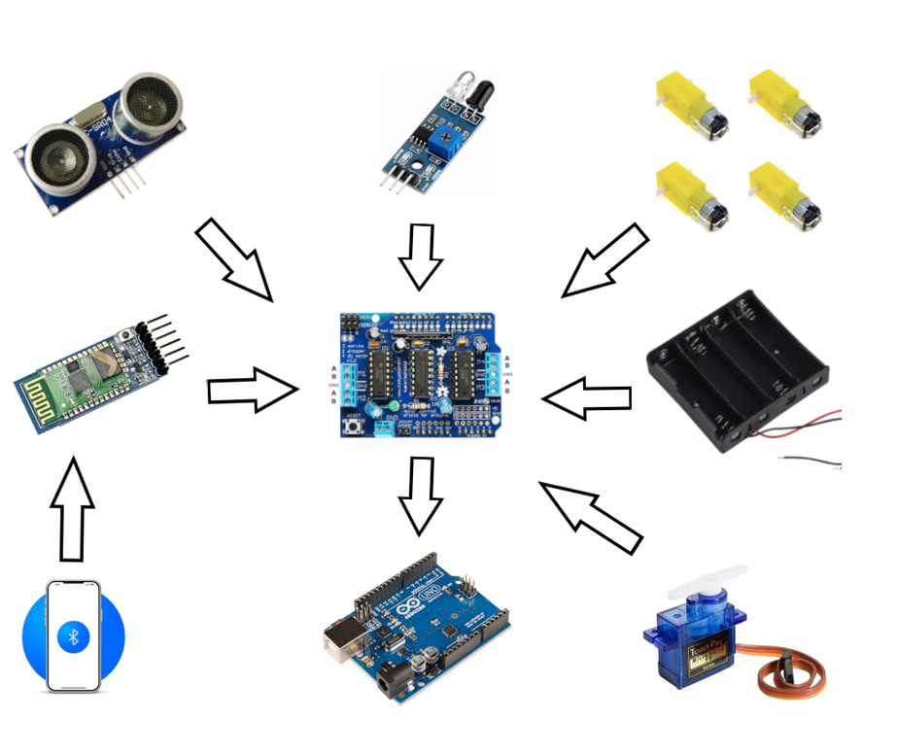
Hardware

Slide 8

Hardware
Arduino UNO
Widely Recognized and versatile Microcontroller Board that is a great starting point for beginner in electronic and coding.
Sensors
It is a device that detects the change in environment and responds to some output on the other system.
L293D Driver Shield
An expansion board for creating four-wheeled vehicle projects designed to work with the Arduino microcontroller.

Slide 9

Hardware
BO Motor Jumper wires Servo Motor HC-05 Bluetooth Module
Rechargeable DC Motors Used to connect different It allows precise control Chips designed to wirelessly
Commonly used in various Point in circuit without angular or linear position, connect compatible device
DIY projects, robotics Soldering Speed and torque. Using low-energy waves.
and portable devices

Slide 10

Software
Arduino IDE Fritzing
It is known as Arduino Integrated Development It is a Software tools that is used to
Environment provides environment for a text Develop electronic hardware by designers to
editor to write codes, message area to write messages, build circuit form prototypes
a text console including toolbar containing various
buttons for various functions with series of menus.

Slide 11
Future Works:
Advanced sensors and Communication System for Efficiency: Can improve the efficiency of the response during emergencies.
Adaptive Control Mechanism for Varied Driving Conditions: Can adapt various driving conditions
Satellite Internet Connectivity for Direct Cloud Communication: Can be used to improve the connection of vehicle directly to cloud

Slide 12
Individual Contribution (WBS)
Bluetooth-controlled Obstacle Avoiding Car
Manish Koirala
Satyam Singh Rajput
Subin Karmacharya
Flowcharts and Circuit Diagram
Code review and debugging
Design the main frame, and frame to holder ultrasonic sensor.
Design the component placement
Anusuya Chudal
Dipendra Gautam
Collection of different hardware components
Testing the functionality of different components
Wiring and connections in the project.
Research into project outcomes and applications
Device monitoring and implementation
Research of different components

Slide 13
Thank You

